Slide 1

Dinosaurs:
Data and Interpretation
Carol Raney, Origins Educator

Slide 2



Carol Odell Raney, M.S.Ed
Experienced elementary, middle school, academy, and university teacher
Freelance writer for By Design science textbooks
Origins Educator & Assistant Professor at Southern Adventist University

Slide 3
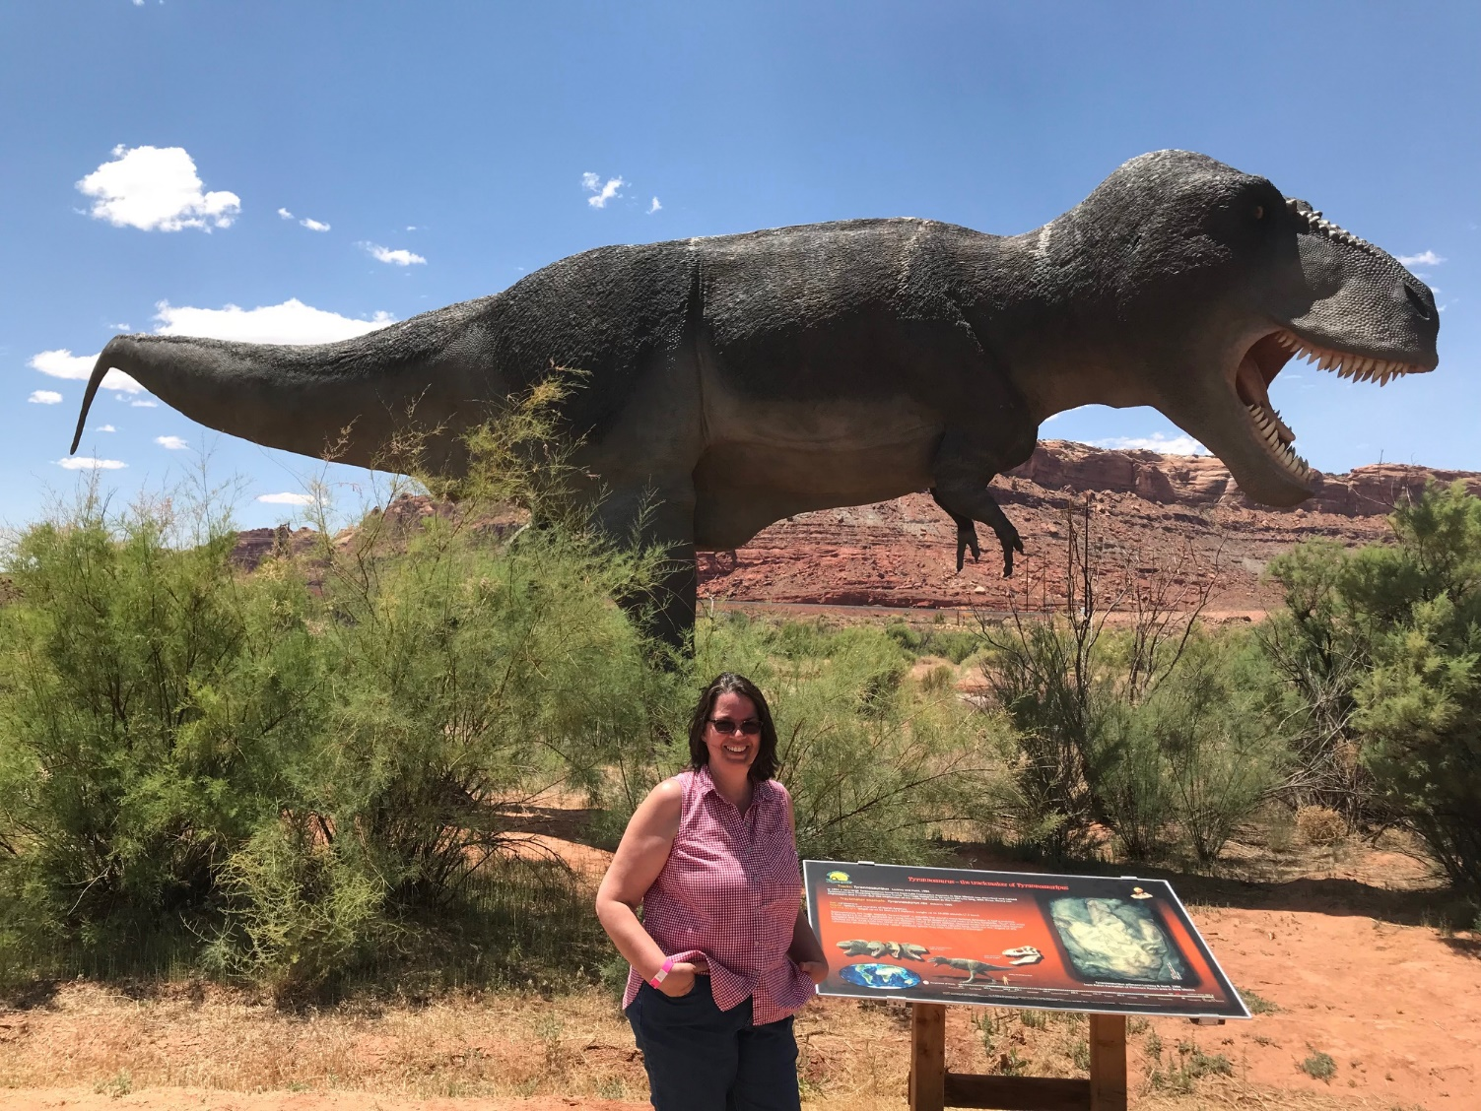
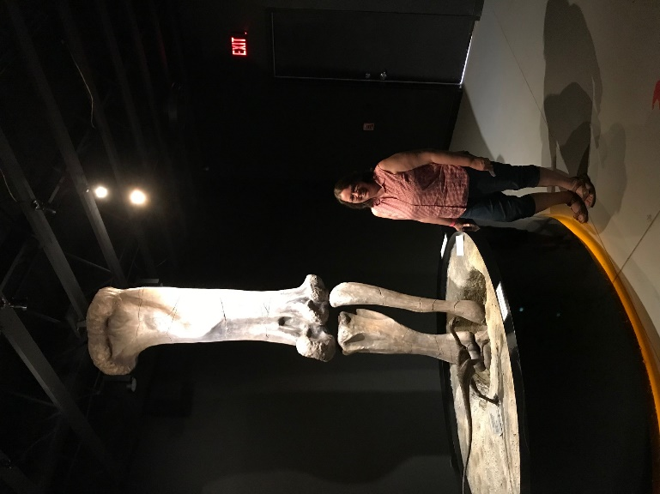
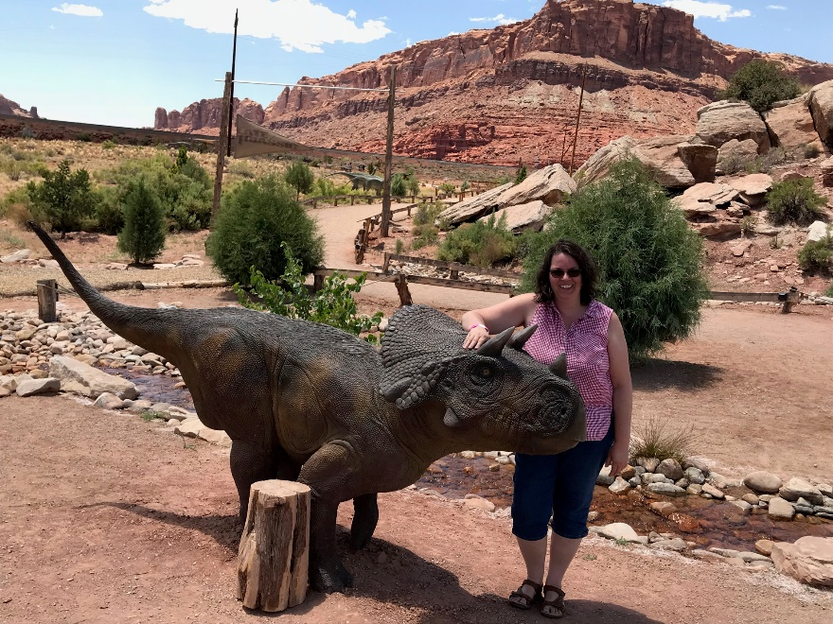

Slide 4
Dinosaurs: Data and Interpretation
Kids love dinosaurs, and they provide a perfect opportunity to help students understand the difference between data and interpretation and examine the evidence through the lens of a biblical worldview. Learn how to do this with your students, and learn about free resources available to supplement specific ByDesign lessons.
(Grades 4 & 6 and Multigrade Cycle 2)
Notes:
Pass out list of resources here…

Slide 5

Link
Southern.edu/origins
Notes:
Origins Resources were created with funding from the Faith and Science Council of the General Conference. They are available online for free at southern.edu/origins.

Slide 6

Exhibit Hall
Booth
1019
Notes:
Please come see us at Booth 1019 in the Exhibit Hall.

Slide 7
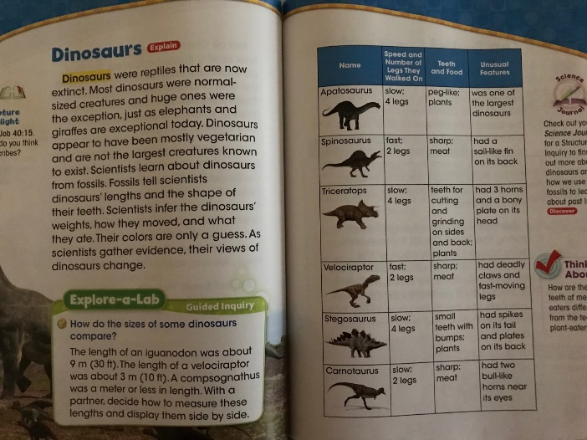
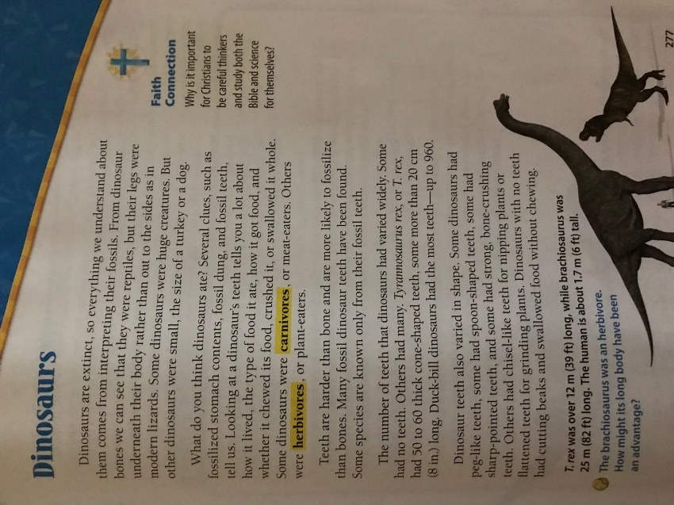
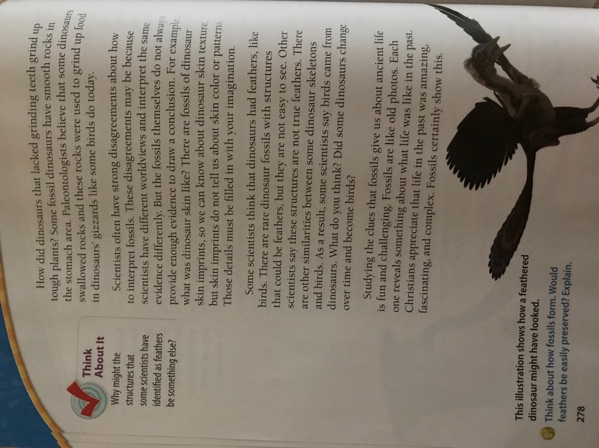
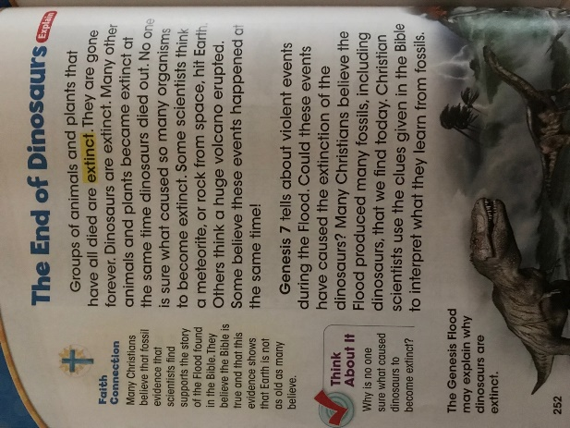
Where are dinosaurs in ByDesign?
Grade 2
Grade 4

Slide 8
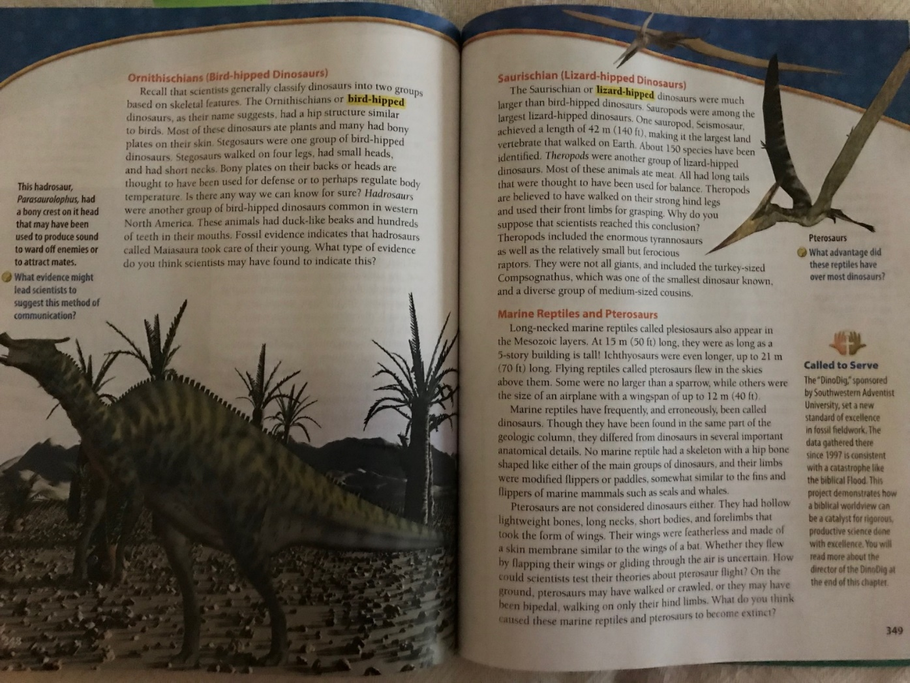
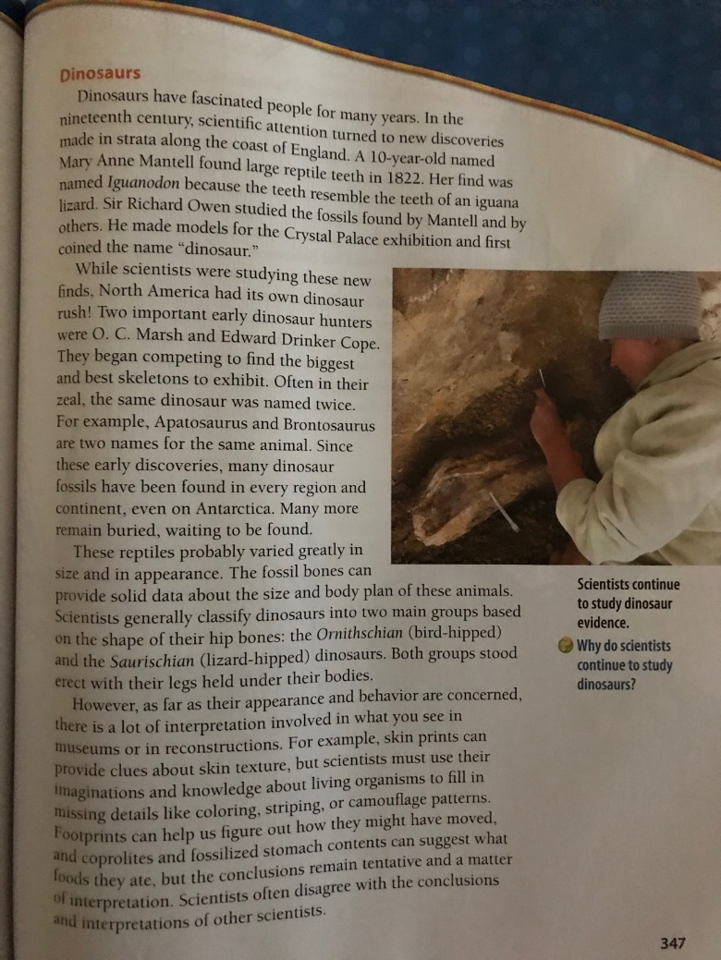
Where are dinosaurs in ByDesign?
Grade 6

Slide 9
Cycle 2

Slide 10
Pre-assessment questions
Where did dinosaurs come from?
Created by God
Created by Satan
Genetically engineered by humans
Evolved from a common ancestor
Actually, they didn’t exist at all
Where did dinosaurs go?
They were destroyed when a meteorite hit the earth millions of years ago
They became extinct during the flood
Most died in the flood, but some survived on the ark and became extinct later
Actually, they aren’t extinct

Slide 11
How certain are you?
1
2
3
4
5
Not very certain
Somewhat certain
Absolutely
certain!!
What evidence convinced you?

Slide 12
Dinosaurs: Data and Interpretation
Kids love dinosaurs, and they provide a perfect opportunity to help students understand the difference between data and interpretation and examine the evidence through the lens of a biblical worldview. Learn how to do this with your students, and learn about free resources available to supplement specific ByDesign lessons.
(Grades 4 & 6 and Multigrade Cycle 2)
Notes:
The point of this breakout session is NOT to definitively answer the questions about the origin and demise of the dinosaurs, but hopefully it will give you some useful things to think about…

Slide 13
Data and Interpretation
Notes:
Let’s start with data and interpretation…

Slide 14
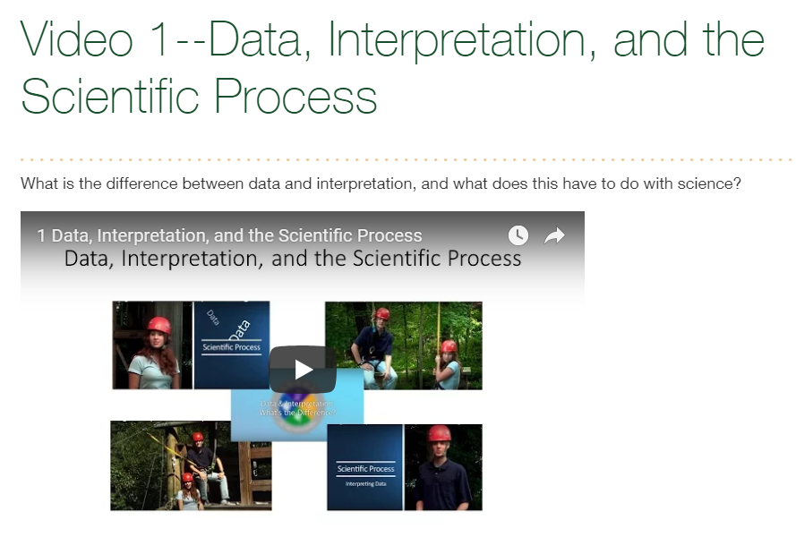
Observe/Ask
Make Hypothesis
Gather Data
(Experiment)
Interpret Data
(Draw Conclusions)
Link
Notes:
This video describes the scientific process

Slide 15
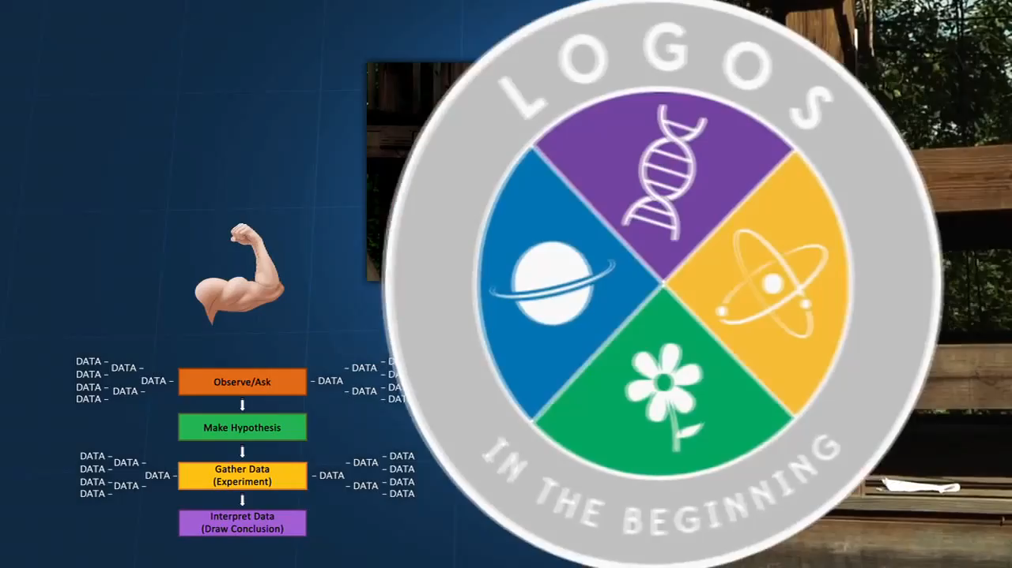
Notes:
5:38 – 6:05 “Let’s review. Data are facts…in ways that make sense to us.”

Slide 16
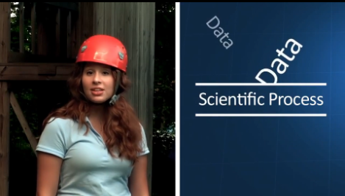
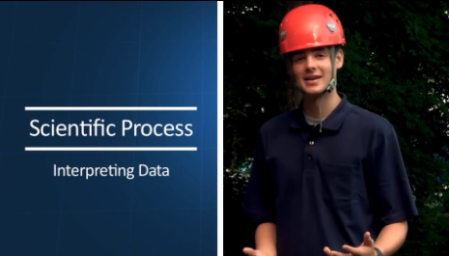

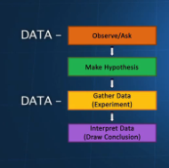
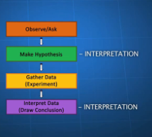
Science = Gathering Data &
Interpreting Data
Notes:
Using dinosaurs to help us understand how the process of science works, focusing specifically on the distinction between data and interpretation
Science – like an onion with multiple layers to peel back.

Slide 17

Important foundational information
Videos 1-4
Data, Interpretation, and the Scientific process
Science: Not as Simple as You Might Think
Worldview and Science: What You Believe Makes a Difference
Science and the Bible
Where to find them:
#1
Southern.edu/origins
#2
Index of Origins Resources by Topic
#3
Science Worldview and the Bible
Notes:
…it’s important to think about some important foundational information. This is outside the scope of this breakout session, but here’s where to find them.

Slide 18

Important foundational information
Videos 1-4
Data, Interpretation, and the Scientific process
Science: Not as Simple as You Might Think
Worldview and Science: What You Believe Makes a Difference
Science and the Bible
Notes:
This important content is also covered in the Science Skills section at the beginning of the ByDesign textbooks. The content builds throughout grades 5-8, with a comprehensive summary in the grade 8 book.

Slide 19
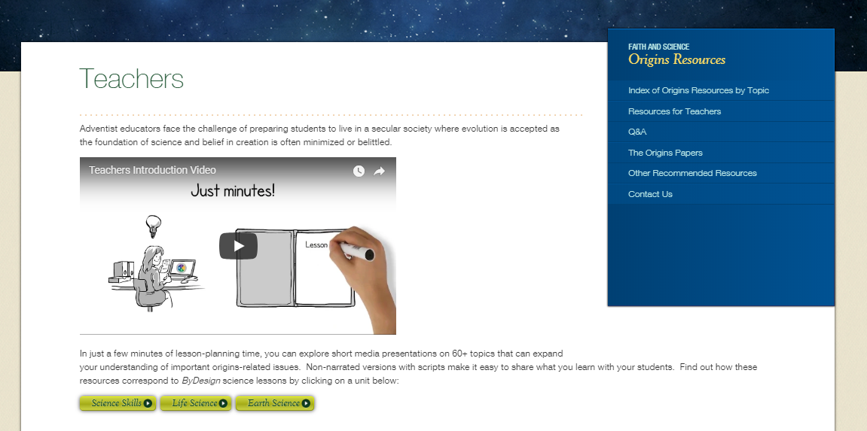
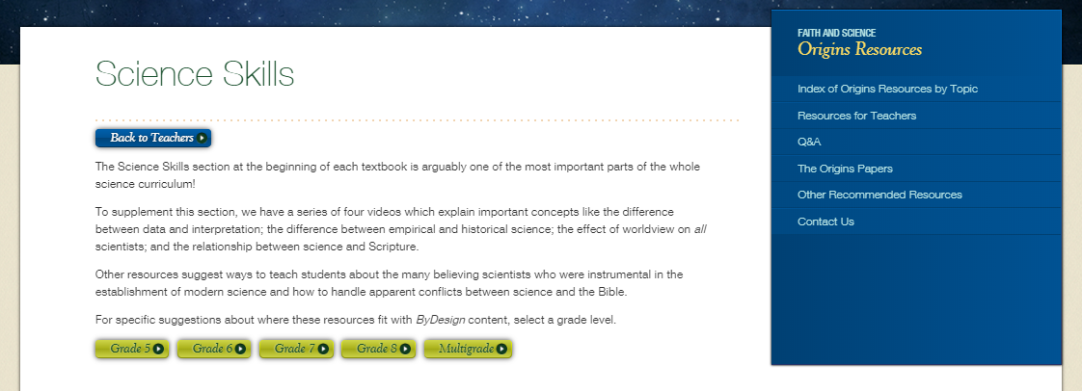
Southern.edu/origins
#1
#2
#3
#4
Notes:
Follow these steps to see which ones we recommend for each grade level in the Science Skills section at the beginning of each book.

Slide 20

Link
Origins 101-12 Data, Interpretation, and Evaluating Scientific Claims
Notes:
Origins 101—Data, Interpretation, and Evaluating Scientific Claims

Slide 21
Definition of Data
Data are facts or pieces of information
Data come from:
  Observations
  Measurements
Notes:
As the video clip pointed out, data are facts or pieces of information that we gather using our senses. Things we can see, hear, touch, taste, count, measure, etc.

Slide 22

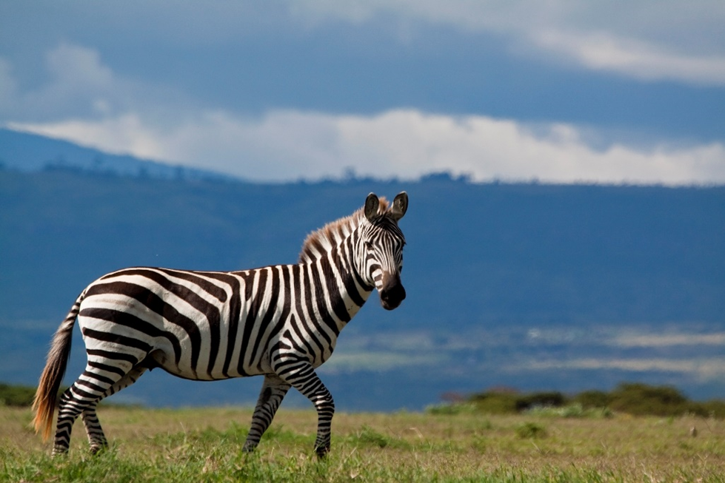

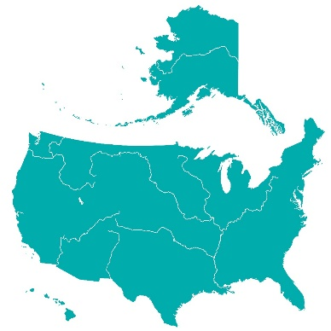



Data—Observed
The Mississippi River flows
toward the Gulf of Mexico
The colors on this frog
Zebra stripe patterns
The leaves of non-evergreen trees turn colors in the fall
Notes:
Examples of data gathered by observation…

Slide 23
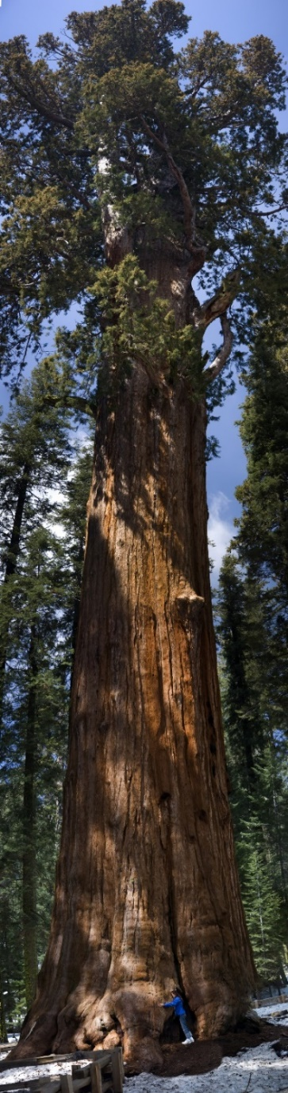
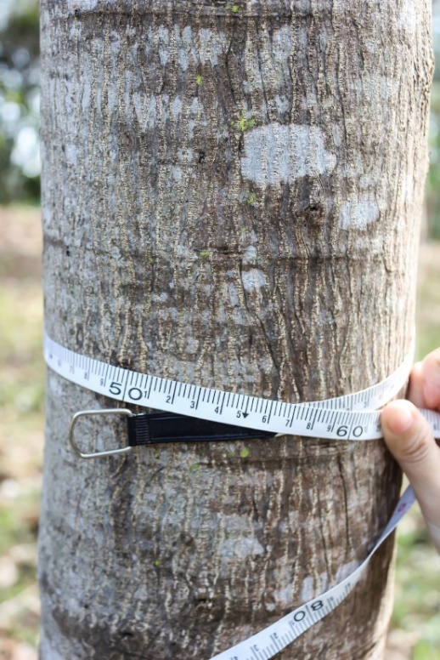


Data--Measured
The circumference of this tree is 55 cm
Hummingbird wings
beat up to 70 times
per second
Poison ivy plants have clusters of 3 leaves
This Sequoia tree is 250 feet tall
Notes:
Examples of data gathered by counting or measuring…

Slide 24



Definition of Interpretation
A conclusion we draw about the data
One tree is taller
than the other
HOW leaves change color
WHY hummingbird wings beat faster than eagles’ wings
Notes:
An interpretation is a conclusion we draw about the data. / It may be as simple as one tree is taller than the other, / or it may deal with how or why something happens.

Slide 25
Scientific Process
Observe/Ask
Gathering
Data
Make Hypothesis
Interpreting
Data
Gather Data/Experiment
Draw Conclusions
Notes:
VIDEO 1--Interplay back and forth between data and interpretation
What often puts the scientific process into motion is data. We notice something and begin to ask questions. Then we gather more data as we experiment to try to answer the question.
Our hypothesis is kind of like a preliminary interpretation, but our final interpretation comes after we have gathered the data.

Slide 26
Scientific Process
Gathering
Data
Interpreting
Data
Notes:
We can condense the scientific process into two steps: gathering data and interpreting data

Slide 27

There can be more than one interpretation of the same data
Right
Wrong
Notes:
There can be more than one interpretation of the same data (we see this a lot in origins)
Interpretations can be right / or they can be wrong.

Slide 28
Interpretations can be…
Mutually Exclusive
Creation
Evolution
Notes:
And sometimes different interpretations are mutually exclusive—which means that they both can’t be true at the same time.

Slide 29
Important Skills—
Recognize, Differentiate, Think, Evaluate
Gathering
Data
Interpreting
Data
Dinosaurs!
Notes:
It’s important to be able to recognize whether something is data or interpretation and to be able to think carefully and evaluate interpretations faithfully. Dinosaurs provide excellent practice!

Slide 30
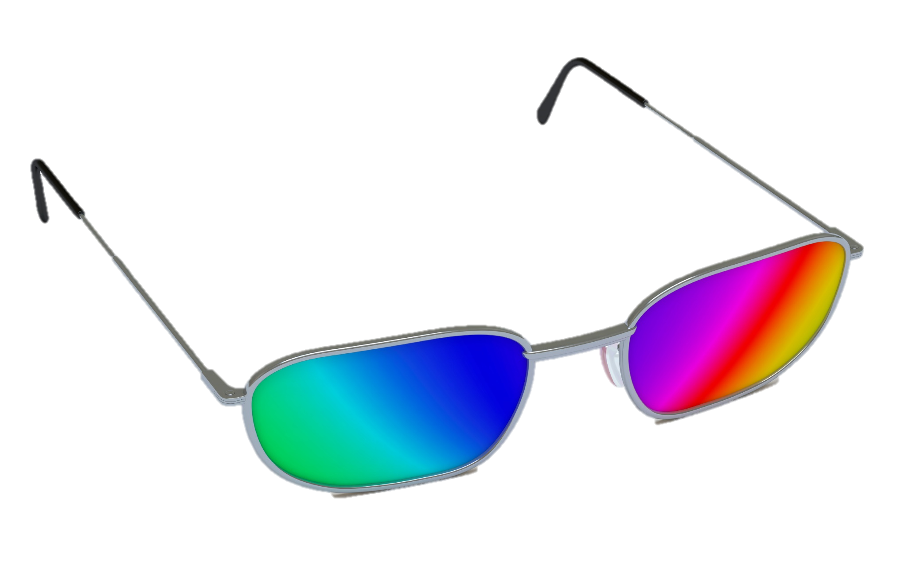
Interpretations are affected by…
Worldview
Notes:
Another important point:
Interpretations are affected by the worldview of the scientist who makes them. A worldview is like a lens through which we view the world.

Slide 31
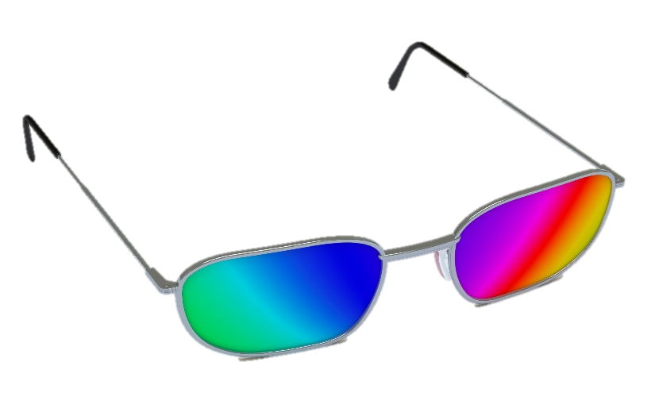
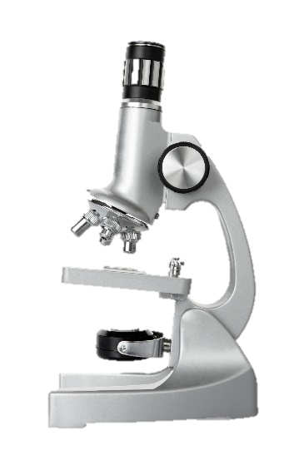

Biblical Worldview
Naturalism
Nature, Science, & the Supernatural
Nature
& Science
Notes:
Let’s define two worldviews: Naturalism is a worldview that believes nature is all that exists and uses the scientific method to investigate reality. A biblical worldview believes that reality includes both the natural and the supernatural, and looks to the Bible for ultimate truth.

Slide 32
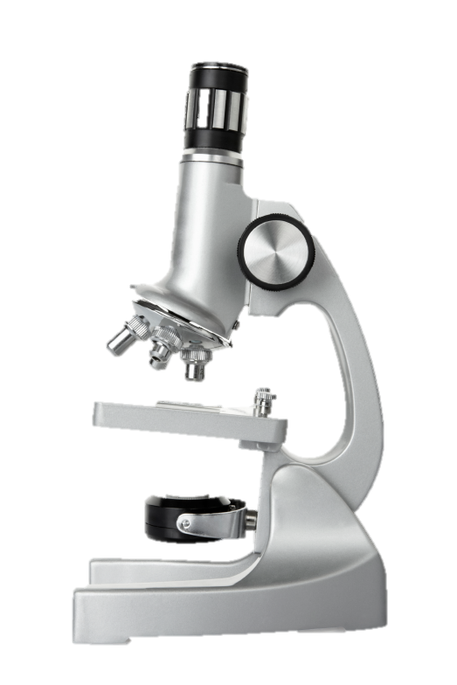
Biblical Worldview
Naturalism
Natural
explanations
Natural
explanations
Data from senses
Data from senses
Notes:
Both of these worldviews value science and look for natural explanations about reality / by gathering data through our senses.

Slide 33
Biblical Worldview
Naturalism
WILL
Consider
Divine Intervention
Will NOT
Consider
Divine Intervention
Notes:
But a biblical worldview will also consider the possibility of divine intervention—/ which naturalism will not.

Slide 34
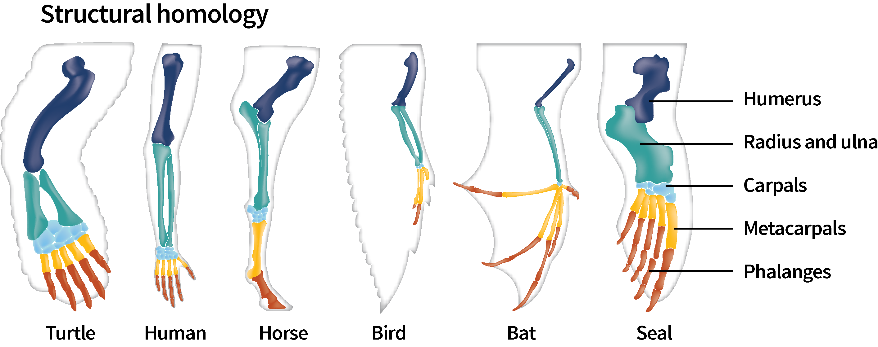
Data
Same pattern of bone structure
Notes:
EXAMPLE to practice…
Lots of animals have the same pattern of bone structure in their forearms. / This is data that can be observed by anyone.

Slide 35
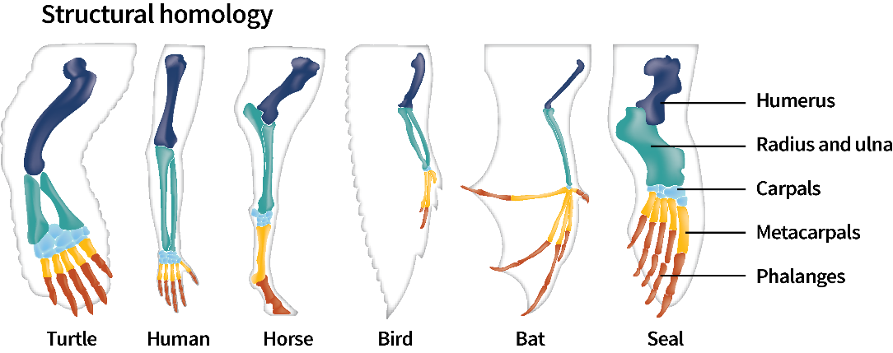
Interpretation
Biblical Worldview
Naturalism
Effective
design
Common
ancestor
Notes:
Scientists with different worldviews look at the same data but arrive at different interpretations of the data. / A scientist with a naturalistic worldview will conclude that all these animals have the same pattern of bone structure because they evolved from a common ancestor. / But a scientist with a biblical worldview will conclude that God efficiently used an effective design in multiple animals.

Slide 36
Interpretation
Biblical Worldview
Naturalism
Effective
design
Common
ancestor

Slide 37
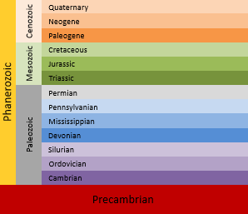
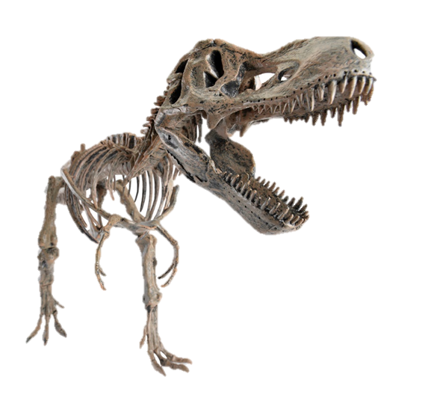
Can you tell the difference?
Dinosaur fossils appear in the Mesozoic layers
Dinosaurs did not exist until after the Permian layers were deposited
Interpretation
Data
Notes:
The location of dinosaur fossils in certain layers is observable data. / Using their relative location to draw conclusions about when they existed is interpretation.

Slide 38

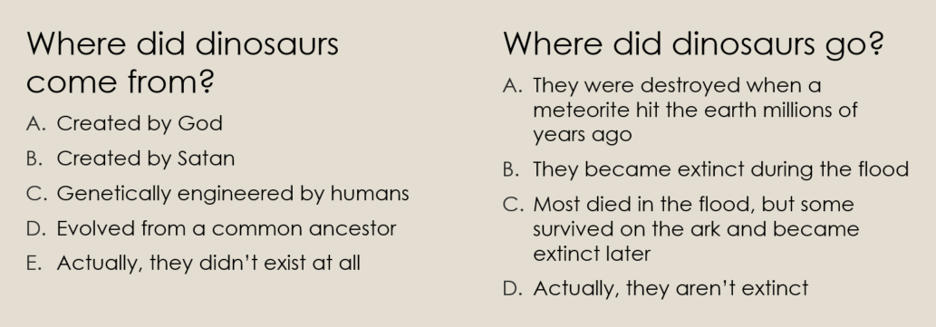
Notes:
The answers to these questions are all interpretations of data
Naturalistic scientists – evolution and extinction by meteorite
Scientists with a biblical worldview – creation, amalgamation (Adventists only); still occasionally hear some say that they didn’t really exist

Slide 39
Data and Interpretation
INTERPRETATIONS
Data:
Bones, Teeth
Eggs, Tracks,
etc.
Remains of
previously living
Physical characteristics
(size, legs, teeth)
Behaviors
Origin & Demise
More evidence needed
Notes:
Not all interpretations are that controversial. I picture a continuum like this… Scientists from different worldviews may disagree about their interpretations of where dinosaurs came from but there are lots of simpler interpretations where there is probably agreement—like dinosaur bones being the remains of previously living creatures of a certain size and shape.

Slide 40
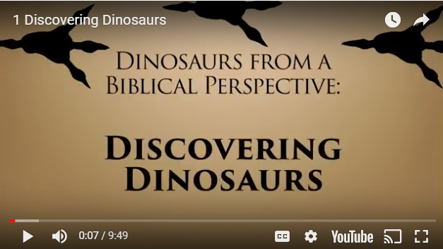
Link
Notes:
See if you can differentiate between data and interpretation in this video… (especially look for observable data)
Stop at 7:20 (after Leonardo’s last meal)

Slide 41


Slide 42
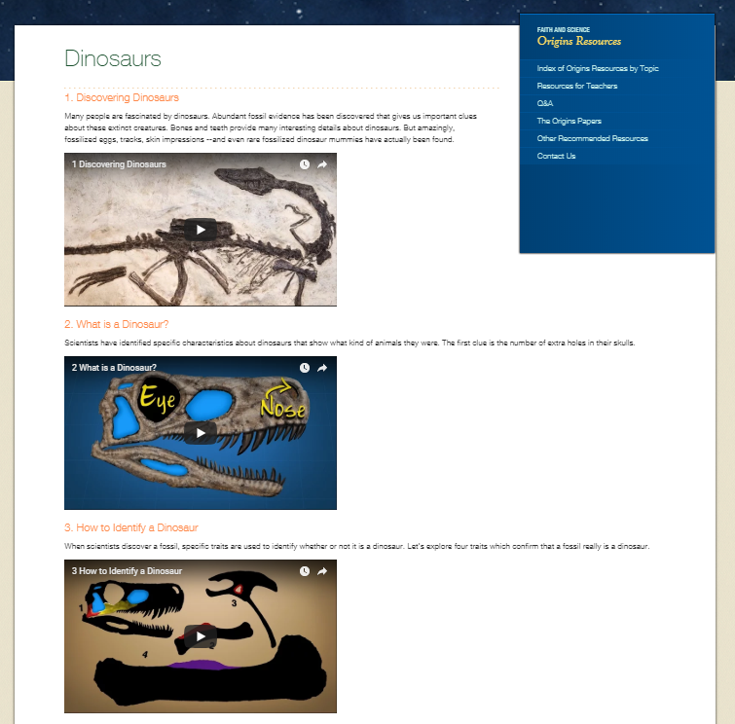
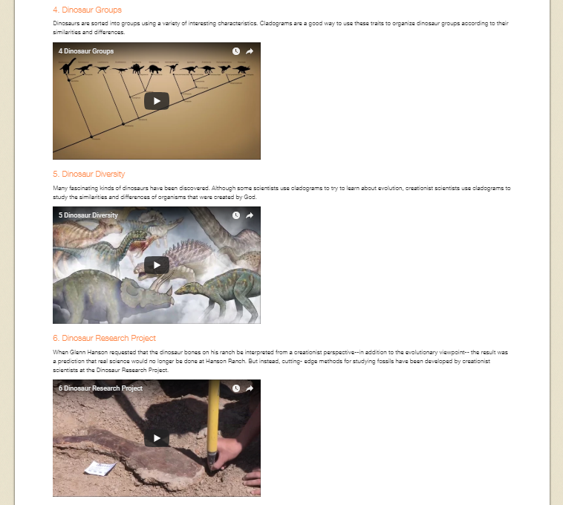

Slide 43
Examples of Data & Interpretation
Data
Interpretation
Eggs
Bones
Teeth
Tracks
Skin impressions
Mummies with preserved soft tissues
Coprolites (preserved poop!)
Evidence of bone disease and injuries in the process of being healed
Bones with broken tips of teeth from a predator
Estimate size and shape
Eating habits
Walking on 2/4 legs; speed
Notes:
Mostly data (this bone was found here…)
Some interpretations/conclusions

Slide 44
Data and Interpretation
INTERPRETATIONS
Data:
Bones, Teeth
Eggs, Tracks,
etc.
Remains of
previously living
Physical characteristics
(size, legs, teeth)
Behaviors
Origin & Demise
More evidence needed
Notes:
Video 1 – mostly telling about data, with some basic interpretations (previously living, size and shape, how they walked or ate)

Slide 45
Examples of Data & Interpretation
Data
Interpretation
One/few bones vs. near-complete skeletons
Size and shape
Notes:
Scientists are pretty good at figuring out the probable size and shape of dinosaurs from the bones they find and their knowledge of comparative anatomy.

Slide 46
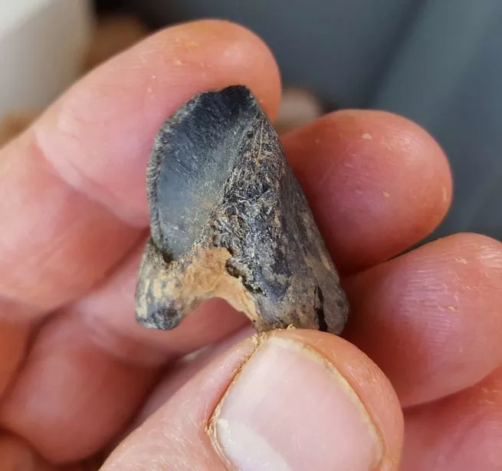
Sometimes single specimens are found
First triceratops-like dino found in the eastern US, in Mississippi
Tentative ID: horned dino like triceratops
2017
Notes:
As mentioned in the video…sometimes dinsoaurs are known from only a single/few bones or teeth. When that happens, interpretations are understandably more tentative. (notice they say this is LIKE a triceratops, not that is IS one)
A fossilized tooth of a horned dinosaur found in Mississippi.
George Phillips, MDWFP Museum of Natural Science.
https://www.popsci.com/dinosaur-tooth-north-america

Slide 47
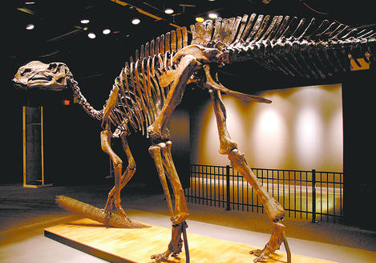
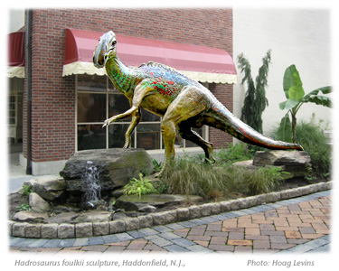
Sometimes near-complete skeletons are found
Hadrosaurus foulkii – most complete dinosaur discovered to date (1858)
Haddonfield, NJ
Notes:
Other times much more complete skeletons are found. Most complete dinosaur ever discovered to date. Found/described in Haddonfield NJ by William Foulke in 1858. Mount of skeleton displayed in 1868. Incidentally—interesting to teach students how species names are assigned (often named in interesting ways). AND fun to include study of dino discoveries in social studies unit about the American west (many discoveries as people explored and made the transcontinental railway. Cope and Marsh competition.
Left picture: credit: Katie O’Toole Clark/ ANSP, via NJEnjoy.com
http://www.youdontknowjersey.com/2012/06/get-to-know-your-nj-symbols-hadrosaurus-foulkii/#!prettyPhoto
Right picture: http://hadrosaurus.com/
https://www.youtube.com/watch?v=9NwXn5C6S8Q
http://jerseymanmagazine.com/when-hadrosaurs-roamed-haddonfield/

Slide 48
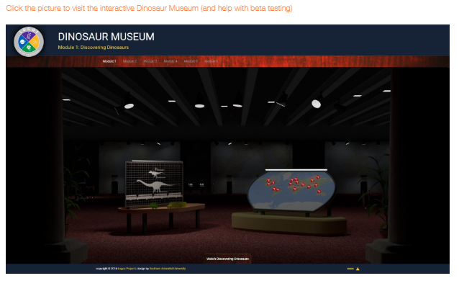
Notes:
Southern.edu/origins…Resources by topic…Dinosaurs (scroll to the bottom of the page)
If you click on the map/timeline options…

Slide 49
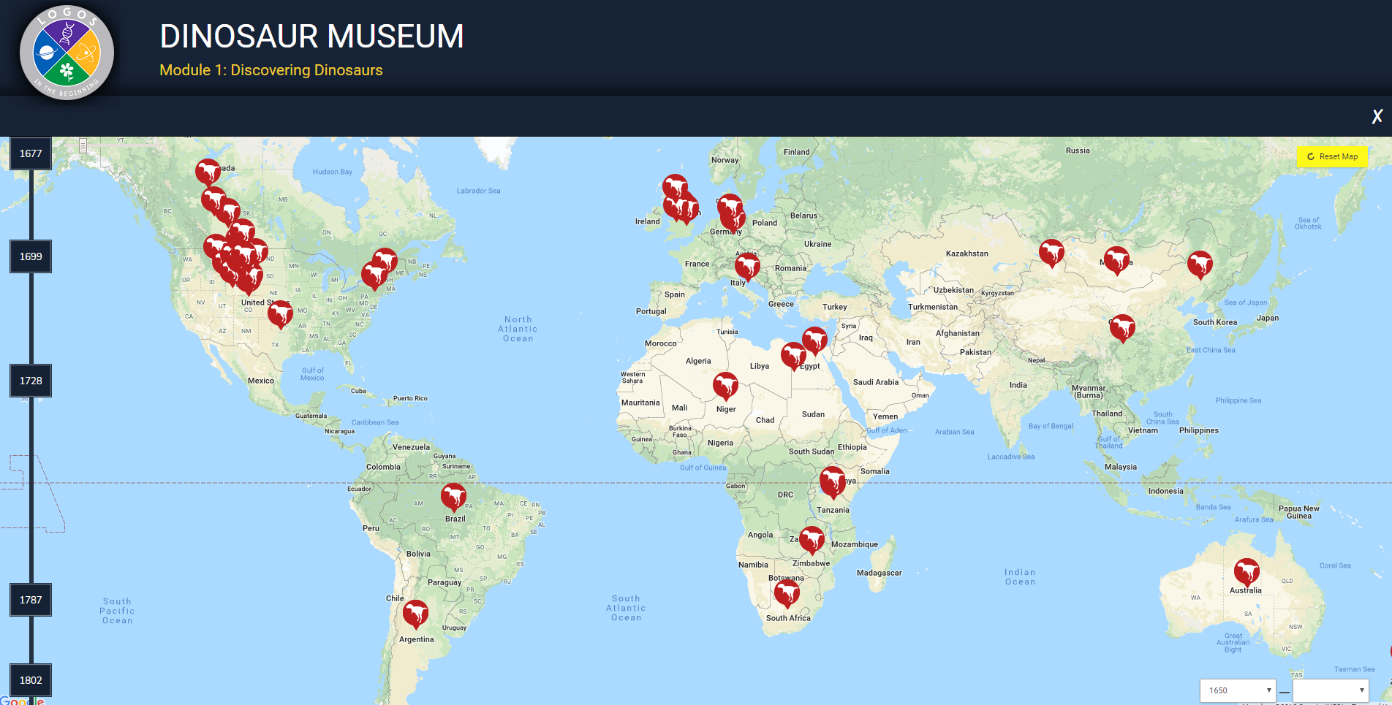
Notes:
…this is what you will see. You can either click on the dates or the places on the map to learn about specific dinosaur discoveries.

Slide 50
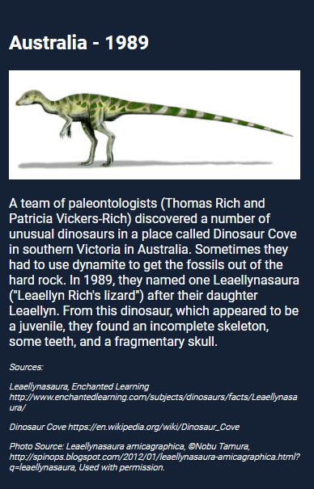
Leaellynasaura
Notes:
If you click on the one in Australia, you see this…they named the discovery of a juvenile dinosaur after their daughter

Slide 51
Notes:
If you click on this option instead…

Slide 52
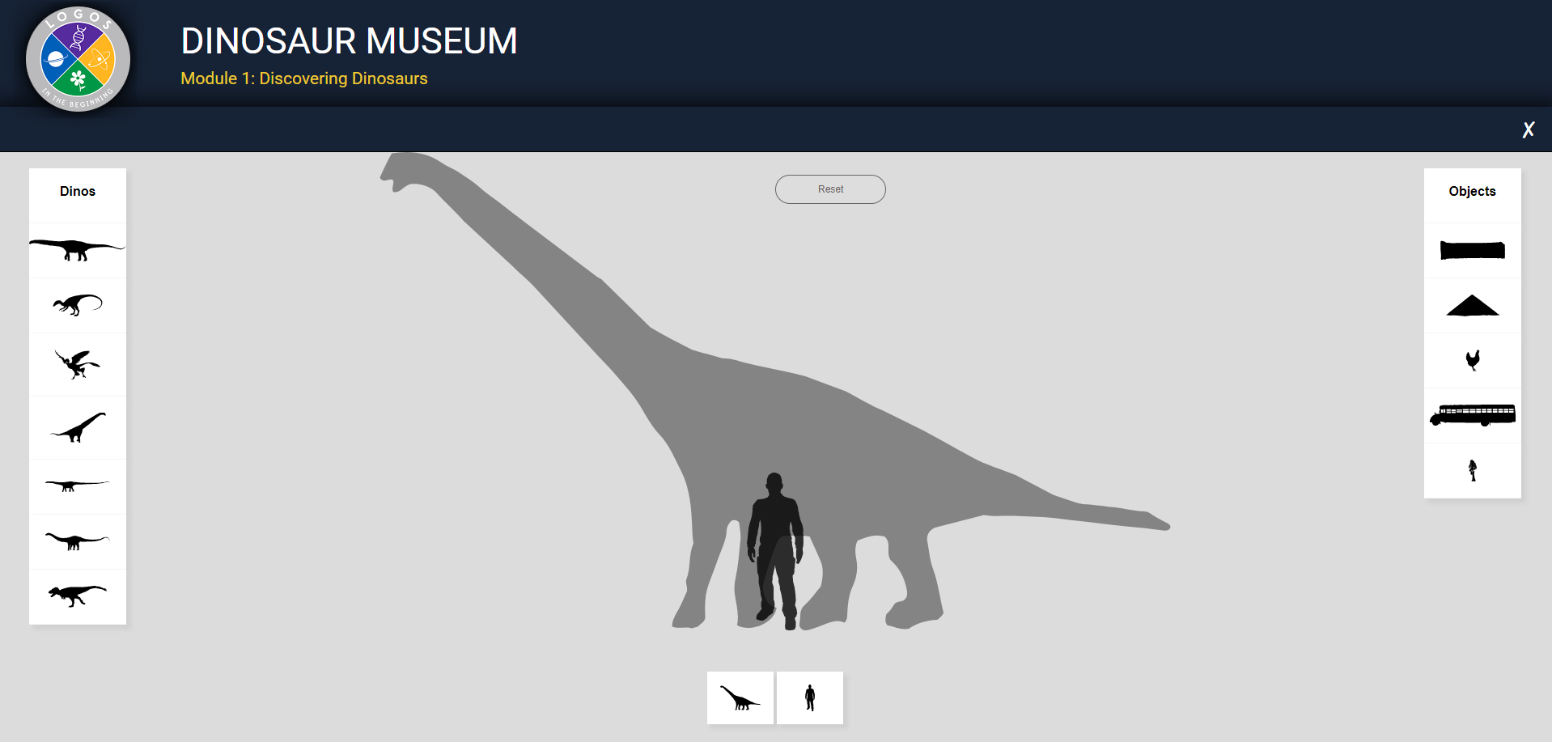
Notes:
…it takes you to this activity that compares sizes of various dinosaurs with things like people and school buses

Slide 53
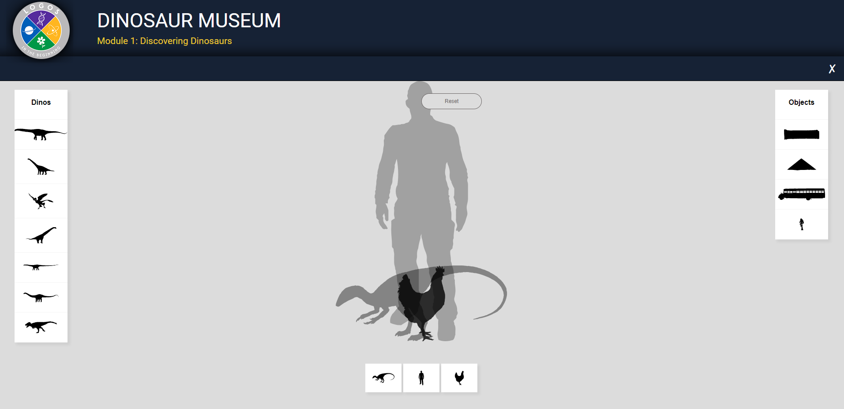

Slide 54
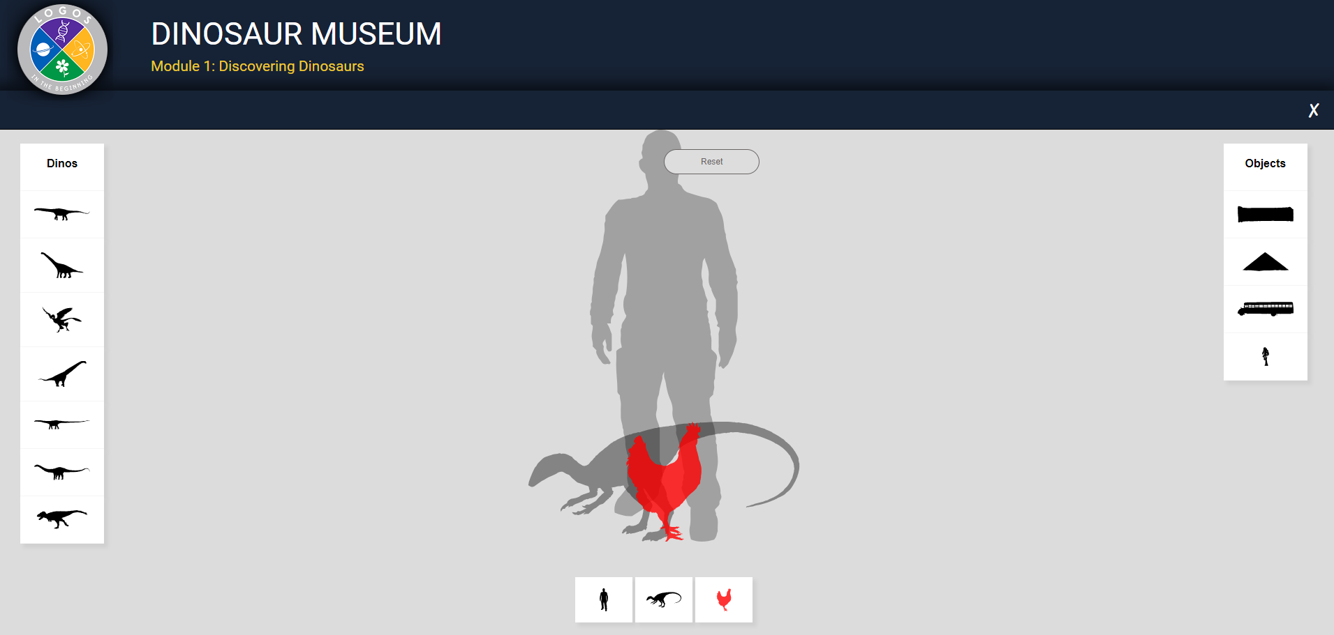

Slide 55
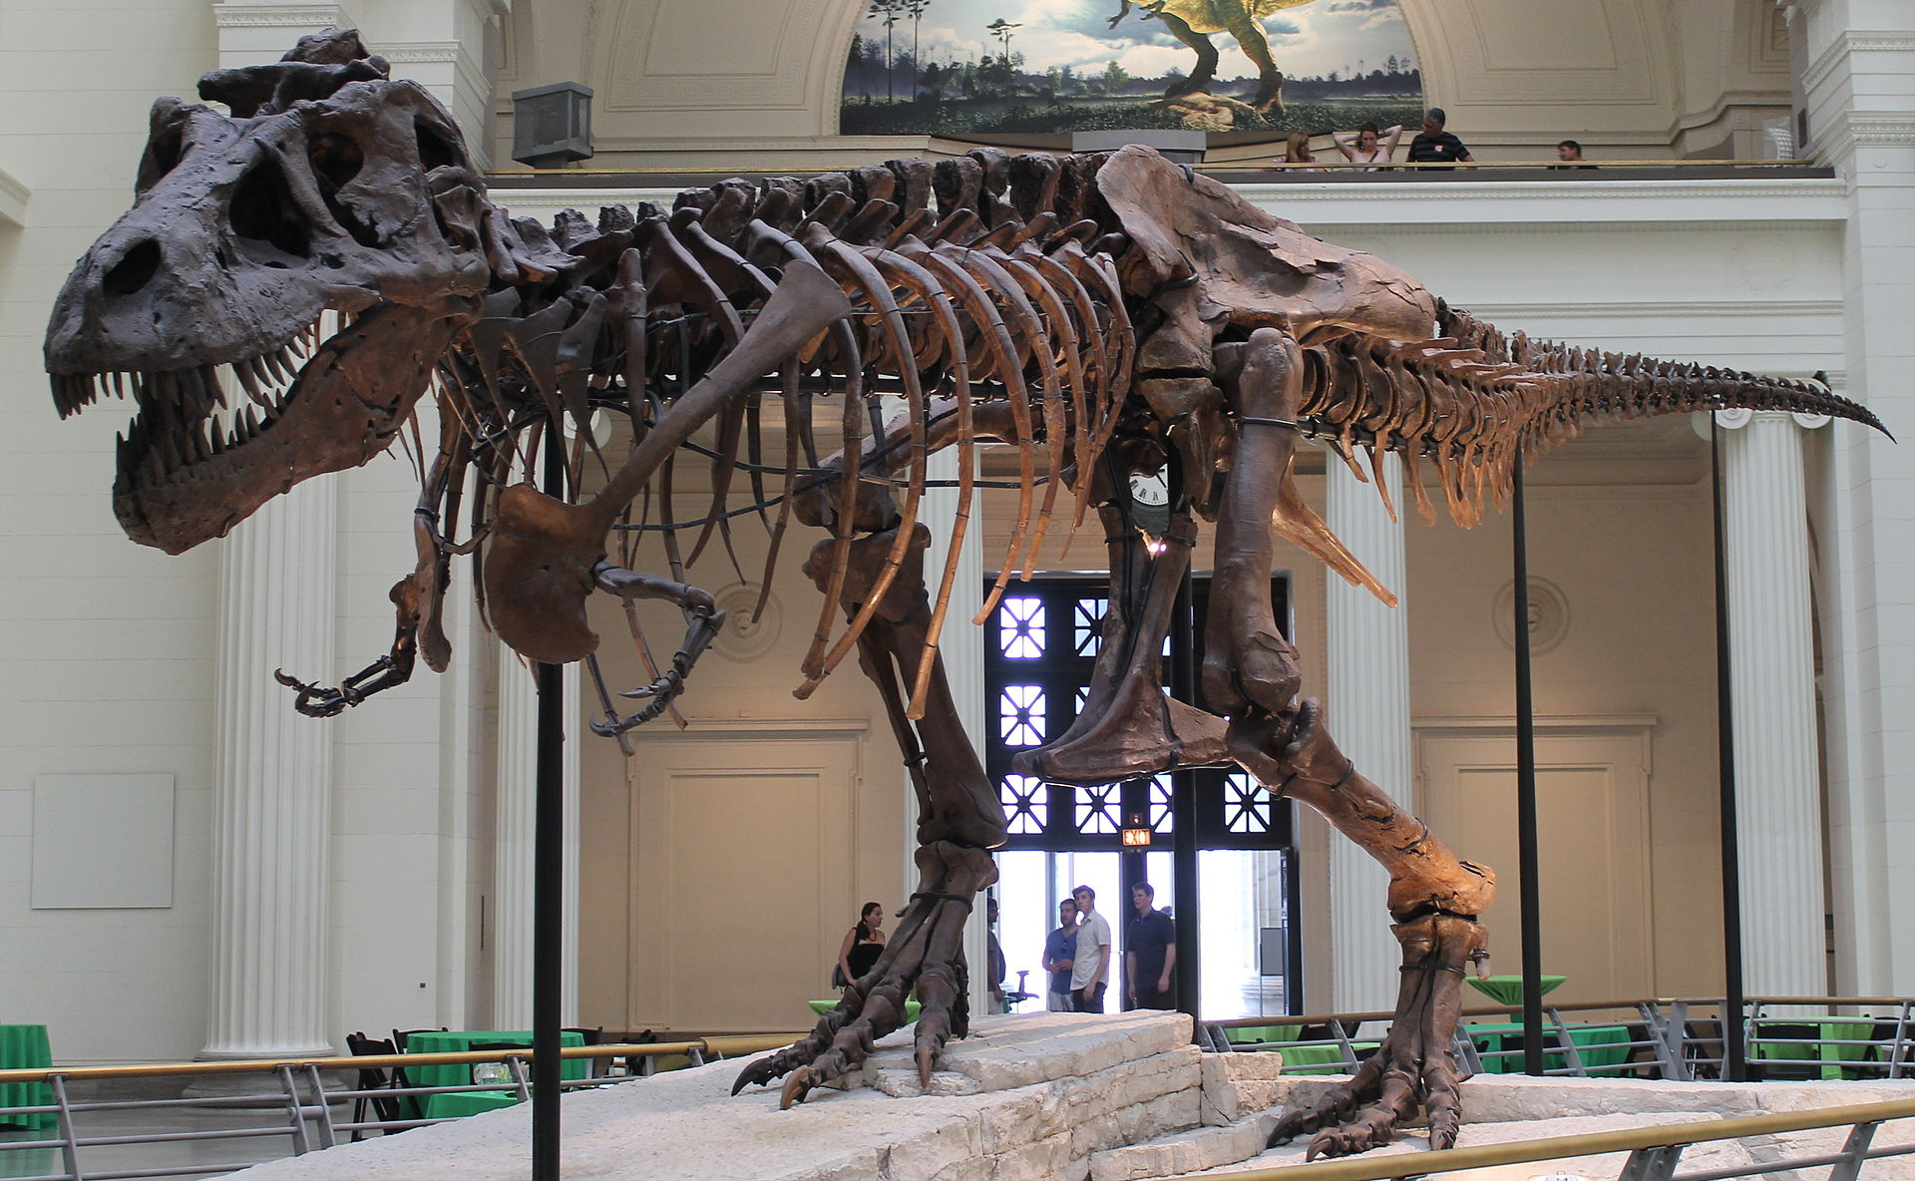
Sometimes near-complete skeletons are found
Sue (T-rex) 1990
Data:
90% complete
Hip bones above the skull
Leg bones intertwined with ribs
Large size
Excellent condition
Interpretation:
Rushing water mixed skeleton together
Before too long it was buried in mud
Notes:
Another near-complete skeleton was found. Really fun story—team about to leave for season…flat tire…Sue took a walk while she waited and found part of this guy sticking out of the hill! Kids’ book about this.
https://en.wikipedia.org/wiki/Sue_(dinosaur)

Slide 56
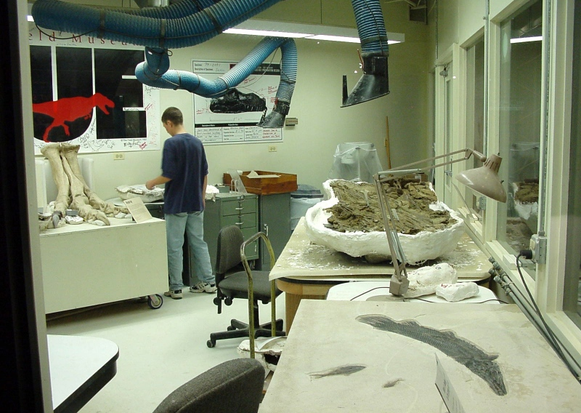
Sue (T-rex) 1990
Notes:
Group from Black Hills Institute searching in South Dakota. Season about over, ready to leave, flat tire…
Sue Hendrickson explore a nearby cliff while they fixed the tire. A record 90% complete.
Picture credit: (left) https://en.wikipedia.org/wiki/Sue_(dinosaur)#/media/File:Field_fg06.jpg
(right) By Connie Ma from Chicago, United States of America - Sue, the world's largest and most complete dinosaur skeleton. Uploaded by FunkMonk, CC BY-SA 2.0, https://commons.wikimedia.org/w/index.php?curid=20207230

Slide 57
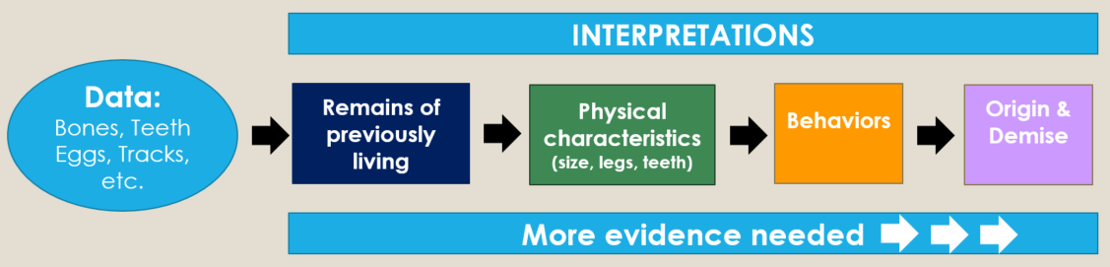
Which part is data?
Which part is interpretation?
First triceratops-like dino found in the eastern US, in Mississippi
“A fluke dinosaur tooth find could help us understand the history of North America. Horned dinosaurs may have crossed an ancient land bridge.”
Notes:
Let’s go back to this tooth and distinguish between the data and interpretation. Teach your kids to peel back the various layers and then evaluate the pieces.
A fossilized tooth of a horned dinosaur found in Mississippi.
George Phillips, MDWFP Museum of Natural Science.
https://www.popsci.com/dinosaur-tooth-north-america

Slide 58
Examples of Data & Interpretation
Data
Interpretation
One/few bones vs. near-complete skeletons
In a life-like position vs. jumbled bones
Size and shape
Buried quickly vs. transported

Slide 59
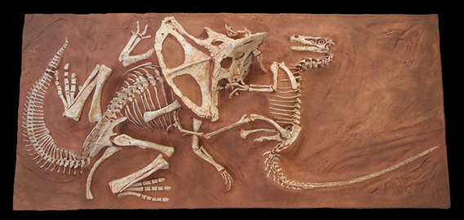
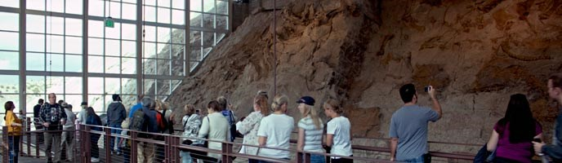
Life-like position vs. jumbled bones
Notes:
Very famous “fighting dinosaurs” vs. jumbled bones at Dinosaur National Monument
https://www.amnh.org/exhibitions/fighting-dinos/the-fighting-dinosaurs/
Picture from https://www.gastondesign.com/wp-content/uploads/velo-proto-fighting-pair-plq-email.jpg
Dinosaur National Monument, Quarry Exhibit Hall
https://www.nps.gov/dino/planyourvisit/quarry-exhibit-hall.htm

Slide 60
The Fighting Dinosaurs (in situ)
“Apparently locked in combat, these two fighting dinosaurs were remarkably preserved in this action pose some 80 million years ago.
…Velociraptor has embedded its deadly foot claw into the neck of the crouching Protoceratops…
…Protoceratops appears to have bitten and broken the right arm of the Velociraptor, whose left hand grips the head of the Protoceratops.”
“A sudden sand flow may have quickly buried these foes, capturing them in this fighting position.”
Notes:
Another factor: condition of the data
Quotation from the American Museum of Natural History
https://www.amnh.org/exhibitions/fighting-dinos/the-fighting-dinosaurs/
Picture from https://www.gastondesign.com/wp-content/uploads/velo-proto-fighting-pair-plq-email.jpg

Slide 61
Examples of Data & Interpretation
Data
Interpretation
One/few bones vs. near-complete skeletons
In a life-like position vs. jumbled bones
Excellent condition vs. evidence of decay or destruction
Size and shape
Buried quickly vs. transported
Buried quickly vs. lying exposed to weathering or scavengers

Slide 62
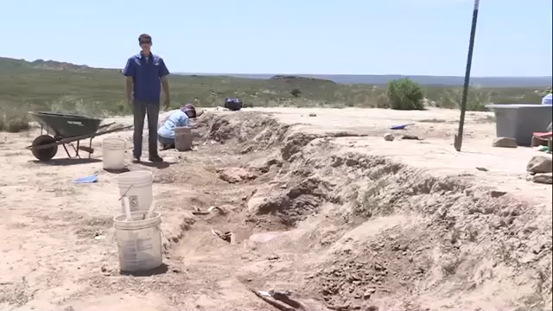

Slide 64
Dino Dig
“The normally graded nature of the bonebed gives evidence that the bones and matrix were deposited as a subaqueous debris flow, thus representing a single sedimentation event for the estimated 500 or more dinosaurs.”
http://dinosaurproject.swau.edu/project/abstracts/gsa2015weeks.html

Slide 65
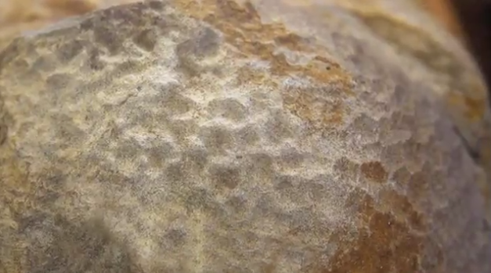
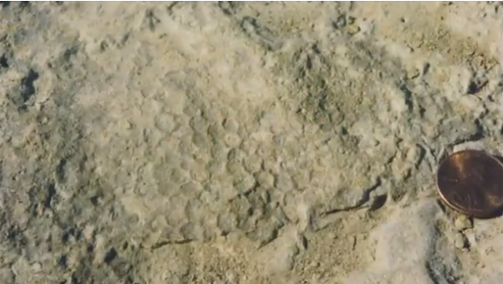
Preserved skin impressions
Notes:
Round or polygon-shaped plates or scales
Thick wrinkled skin with bony knobs or bumps

Slide 66
Locomotion
Size & Shape
Behaviors
Data:
Bones, Teeth
Eggs, Tracks,
etc.
Good or bad parents
Notes:
Good or bad parents – interpretations change

Slide 67


Egg thief or good parent?
Eggs in nest of unidentified dinosaur from Flaming Cliffs, Mongolia
1920s – egg thief
1990s – good parent
Oviraptor fossil with eggs
from Flaming Cliffs, Mongolia
Notes:
“Oviraptor Egg On top of one of the nests of dinosaur eggs discovered in 1923 lay the skeleton of an animal thought to be stealing the eggs, Oviraptor philaceratops. In 1993, additional eggs were found in the Gobi that closely resembled those of 70 years earlier. One of the eggs contained a fossilized embryo, which researchers identified as a developing oviraptorid -- a member of the group that includes Oviraptor. Later discoveries of two adult oviraptorids sitting on groups of eggs confirmed that they nested in the manner of modern birds -- transforming the image of Oviraptorfrom that of egg thief to protective parent.”
https://www.amnh.org/dinosaurs/dinosaur-eggs/
Nest photo (left): https://www.amnh.org/dinosaurs/dinosaur-eggs/
Oviraptor fossil with eggs (right) from Flaming Cliffs in Mongolia
American Museum of Natural History © AMNH/D. Finnin

Slide 68

Scutellosaurus (listen for data and interpretation)

Slide 69


Slide 70
Scutellosaurus
Early Jurassic period
Likes to hide
Armor plates hide and shield
Bipedal
Herbivore
From Arizona, USA
Beak and special teeth to eat plants
Same size as a child
Notes:
Scutellosaurus: https://www.youtube.com/watch?v=U7Bm7pdJcoo

Slide 71
Locomotion
Size & Shape
Behaviors
Bipedal
Data:
Bones, Teeth
Eggs, Tracks,
etc.
Small size
Armor plates
Beak and special teeth
Diet
Likes to hide
Where
When
Arizona, USA
Early Jurassic period
Notes:
Click through…then…
Arizona – what clues might tell you whether he actually lived in Arizona or not? (as opposed to having been washed in from elsewhere)

Slide 72
Early Jurassic…

Slide 73

The Geologic Column
Link
Important Terminology
Notes:
The Geologic Column—Important Terminology

Slide 74




The Geologic Column
Notes:
The interesting rock layers around the world make up the geologic column. Scientists have illustrated it in a chart with several major divisions…

Slide 75
The Geologic Column
Notes:
The Mesozoic layers are the ones that contain the dinosaur fossils

Slide 76
The Geologic Column
Notes:
The Mesozoic is divided into three sections: Triassic, Jurassic, and Cretaceous. According to the video clip, Scutellosaurus was from the “early Jurassic period.”

Slide 77


Two Sets of Terminology
Chronostratigraphic
Geochronologic
Notes:
There are two sets of terminology used to describe the geologic column. / Chronostratigraphic terms refer just to the rock layers themselves, / while geochronologic terms refer to the rock layers and the millions of years associated with them.

Slide 78
Important Terminology
Chronostratigraphic (layers)
  Eonothem
  Erathem
  System
  Series
  Stage
Geochronologic (time)
  Eon
  Era
  Period
  Epoch
  Age
Notes:
…early Jurassic PERIOD…

Slide 79
Cenozoic
Cretaceous
Late
Upper
Middle
Middle
Mesozoic
Early
Lower
Phanerozoic
Jurassic
Late
Upper
Middle
Middle
Early
Lower
Paleozoic
Triassic
Late
Upper
Middle
Middle
Early
Lower
Precambrian
Notes:
Periods (or systems) are divided further. Early is lowest…
(We could also say the “lower” Jurassic, if we want to avoid the words with the connotations of millions of years)

Slide 80

Masiakasaurus (listen for data and interpretation)

Slide 81


Slide 82
Masiakasaurus
Vicious lizard
Late cretaceous
68 ma
Theropod like T-rex
Eat meat
Teeth made for fishing; also eats bugs
Madagascar
Not much bigger than a dog
Notes:
https://www.youtube.com/watch?v=TiDDRfLHCew
DIFFERENT TIME PERIOD

Slide 83
Locomotion
Size & Shape
Behaviors
Data:
Bones, Teeth
Eggs, Tracks,
etc.
Not much bigger than a dog
Teeth for fishing
Eats meat (fish and bugs)
“Viscious”
Where
When
Madagascar
Late Cretaceous period
68 ma
Notes:
Click through…then…
Arizona – what clues might tell you whether he actually lived in Arizona or not? (as opposed to having been washed in from elsewhere)

Slide 84
Cenozoic
Cretaceous
Late
Upper
Middle
Middle
Mesozoic
Early
Lower
Phanerozoic
Jurassic
Late
Upper
Middle
Middle
Early
Lower
Paleozoic
Triassic
Late
Upper
Middle
Middle
Early
Lower
Precambrian
Notes:
Late cretaceous

Slide 85
Books and videos are not likely to address the difference between data and interpretation
Consider finding a dinosaur book for kids to use as an example
Data and interpretation are mixed together and it’s up to the reader/viewer to differentiate between them

Slide 86

Pathways book about dinosaurs
Much better at pointing out the difference

Slide 87
Data and Interpretation
INTERPRETATION
Data:
Bones, Teeth
Eggs, Tracks,
etc.
Remains of
previously living
Physical characteristics
(size, legs, teeth)
Behaviors
Origin & Demise
More evidence needed
Notes:
What about their origin and demise?

Slide 88
Origin of dinosaurs
Data
Bones, tracks, teeth, eggs
Found on every continent
Found in Mesozoic layers
Seem to have filled niches like mammals did in the Cenozoic

Slide 89

Some questions to think about
Where did dinosaurs come from?
Where do you think other animals came from?
  Biblical account of creation
  Evidence of design
  Lack of evidence for abiogenesis and macroevolution
What would cause someone to think they had a different origin than any other group of animals?
  Why would God create such ferocious predators?
    What about tigers or parasitic wasps?
    Were ALL dinosaurs ferocious predators?
  Statements by Ellen White
Notes:
It would be pretty hard to argue that they didn’t actually exist. Lots of evidence more consistent with creation than evolution. That leaves…
Adventists are the only ones I’ve ever heard suggesting amalgamation

Slide 90
Some questions to think about
Where did dinosaurs come from?
Satan works through the elements also go garner his harvest of unprepared souls. He has studied the secrets of the laboratories of nature, and he uses all his power to control the elements as far as God allows. When he was suffered to afflict Job, how quickly flocks and herds, servants, houses, children, were swept away, one trouble succeeding another as in a moment. It is God that shields His creatures and hedges them in from the power of the destroyer.
~~The Great Controversy page 589
Notes:
The only quote I could find about Satan and the laboratories of nature was this one. The context is very clearly in relation to controlling the elements. No mention of experimenting with animals.

Slide 91
Some questions to think about
Where did dinosaurs come from?
Questions:
Would the amalgamation of man and beast produce a dinosaur?
What kind of evidence might indicate that hybridization might have happened?
“But if there was one sin above another which called for the destruction of the race by the flood, it was the base crime of amalgamation of man and beast which defaced the image of God, and caused confusion everywhere.” 3SG 64 (1864)
(Republished in Spirit of Prophecy, volume 1, in 1870)
http://www.whiteestate.org/issues/amalg.html
Notes:
In describing the great sin that caused for the destruction of the race by the flood, Ellen White describes what she calls the “base crime” of amalgamation of man and beast. Some have suggested that this might be where dinosaurs came from. Questions: I have no trouble believing people before the flood were smart enough…but would the amalgamation of man and beast produce a dinosaur? What kind of evidence…?

Slide 92
White Estate – amalgamation
Amalgamation of Man
Amalgamation of Beast
The intermarriage of races of men (Seth and Cain) defaced the image of God
The amalgamation of species of animals resulted in confused species
…when Mrs. White “amalgamation of man and beast,” she meant
The amalgamation of races of men, and
The amalgamation of species of animals.
The first “defaced the image of God,” the second “caused confusion everywhere.”
http://www.whiteestate.org/issues/amalg.html
Notes:
This is how the White Estate explains the statement, but is this the simplest explanation?
http://www.whiteestate.org/issues/amalg.html
No mention of dinosaurs in the EGW estate paper

Slide 93

An “Adventist” View…
Reflects the views of some Adventist scientists but certainly not all of them
Notes:
This is a really interesting book—written by a lawyer—that takes that view.
Unfortunate title. Reflects the view of some Adventist scientists that I know but definitely not all of them.
If they WERE experimenting with amalgamation, maybe they did tinker with dinosaurs, but would that mean that ALL dinosaurs originated that way?

Slide 94
Some questions to think about
Where did dinosaurs come from?
A different “take”…
Could there be evidence of the amalgamation of man and beast within the hominid sequence?
“But if there was one sin above another which called for the destruction of the race by the flood, it was the base crime of amalgamation of man and beast which defaced the image of God, and caused confusion everywhere.” 3SG 64 (1864)
(Republished in Spirit of Prophecy, volume 1, in 1870)
http://www.whiteestate.org/issues/amalg.html
Notes:
A different “take” on the question has been suggested…
Rather than dismissing all the suggested intermediates, Dr. Lee Spencer has suggested that the hominid sequence might contain evidence of the amalgamation of man and beast

Slide 95
Ellen White – large animals
“I was shown that very large, powerful animals existed before the flood which do not now exist.” 3SG 92
“There was a class of very large animals which perished at the flood. God knew that the strength of man would decrease, and these mammoth animals could not be controlled by feeble man.” 4SG 121
Questions to think about:
Were ALL dinosaurs large?
What other large animals might these statements refer to?
Notes:
Another quote from EGW that has been used in reference to dinosaurs:
COULD they have been dinosaurs? Could they be something OTHER than dinosaurs?

Slide 96

Some questions to think about
Where did dinosaurs go?
Lots of dinosaur fossils all over the world
  Some buried quickly in place
  Some carried by water and deposited
Evidence of large-scale water catastrophe
Iridium found in both meteorites and Mesozoic layers

Slide 97
According to this statement by Ellen White -- would dinosaurs have been on the ark?
“Every species of animal which God had created were preserved in the ark. The confused species which God did not create, which were the result of amalgamation, were destroyed by the flood.” 3SG 75 (1864)
IF God created the dinosaurs…
IF God created some dinosaurs and humans amalgamated others…
IF God did NOT create any dinosaurs…
Yes
No
Yes, some

Slide 98
Dinosaurs in the Bible?
Name “dinosaur” wasn’t invented until the 1840s
Behemoth—Job 40
Leviathan—Job 41
Behemoth, which I made
Eats grass like an ox
Strength in his loins; power in his belly
Bends his tail like a cedar
Bones are tubes of bronze; limbs like bars of iron
He is first of the ways of God
Lies under the lotus plants
Can cross raging rivers
Outer armor, double mail
Doors of his face
Around his teeth there is terror
Strong scales (tight seal, no air between)
His sneezes flash forth light
Sparks of fire leap forth (out of his mouth)
Out of his nostrils smoke goes forth
Underparts like sharp potsherds
Makes the depth boil like a pot
Notes:
Great compare and contrast activity for your students (comparing Behemoth with elephant, comparing Leviathan with alligator, etc.)
The point isn’t to make a definitive decision but to teach your students how to make observations, compare and contrast, support opinions with evidence, etc.

Slide 99

Dinosaurs in the Bible?
Follow through to logical conclusion…
  If it IS a dinosaur, then God created it
    Behemoth which I made… (Job 40)
    There the ships move along, and Leviathan, which You have formed to sport in it. (Ps 104:26)
  Job was written after the flood…

Slide 100
What about the millions of years?
Radiometric dates
Soft tissue found in dinosaur bones
Notes:
Not millions of years vs. the Bible; millions of years vs. the Bible and other scientific data
Can’t explain the radiometric dates…but neither can we explain quantum physics yet either…

Slide 101
Blood cells
Mary Schweitzer
“the most parsimonious explanation of this evidence is the presence of blood-derived hemoglobin compounds preserved in the dinosaurian tissues.”
Jack Horner 2005 helicopter (cracked bone in half);
  Soft tissue
  Red blood cells
  Osteocytes
Smithsonian.com: https://www.smithsonianmag.com/science-nature/dinosaur-shocker-115306469/
Notes:
Story in Smithsonian.com
https://www.smithsonianmag.com/science-nature/dinosaur-shocker-115306469/

Slide 102
Dinosaurs: Data and Interpretation
Kids love dinosaurs, and they provide a perfect opportunity to help students understand the difference between data and interpretation and examine the evidence through the lens of a biblical worldview. Learn how to do this with your students, and learn about free resources available to supplement specific ByDesign lessons.
(Grades 4 & 6 and Multigrade Cycle 2)
Notes:
This is what we set out to do…let’s end with a couple more opportunities to practice…

Slide 103

Data or Interpretation?
Dinosaurs died in the flood
No dinosaur fossils have been found below the Triassic
Meteorite strikes caused the extinction of the dinosaurs
Some dinosaurs survived the flood but became extinct later during the Ice Age
No dinosaur fossils are found in the Cenozoic
Notes:
Listen to each of these statements and decide whether you think it is data or interpretation. Pause the video if you need more time to think about it.

Slide 104
Identify the Data
Dinosaurs died in the flood
No dinosaur fossils have been found below the Triassic
Meteorite strikes caused the extinction of the dinosaurs
Some dinosaurs survived the flood but became extinct later during the Ice Age
No dinosaur fossils are found in the Cenozoic
Notes:
The two statements in yellow are data The fact that dinosaur bones are only found in the Mesozoic layers—not below the Triassic or above the Cretaceous in the Cenozoic—is data. It can be verified by anyone who does the research. The other three statements about what happened to the dinosaurs are not things that can be verified by observation or experimentation. They are interpretations of the data that are derived from implications of the respective worldviews.

Slide 105

Data or Interpretation?
Birds have feathers
Certain creatures with dinosaurian skeletons also had feathers
Dinosaurs evolved into birds
God created both birds and some dinosaurs with feathers
Smaller dinosaurs living in higher biomes needed feathers to keep warm
Notes:
Here’s another set of statements. Let’s differentiate between data and interpretation
The fact that birds have feathers is observable data that can be easily verified.

Slide 106
Data or Interpretation?
Birds have feathers
Certain creatures with dinosaurian skeletons also had feathers
Dinosaurs evolved into birds
God created both birds and some dinosaurs with feathers
Smaller dinosaurs living in higher biomes needed feathers to keep warm
Notes:
The fossil evidence indicates that certain creatures with dinosaurian skeletons also had feathers, so this is data as well.

Slide 107
Data or Interpretation?
Birds have feathers
Certain creatures with dinosaurian skeletons also had feathers
Dinosaurs evolved into birds
God created both birds and some dinosaurs with feathers
Smaller dinosaurs living in higher biomes needed feathers to keep warm
Notes:
The claim that dinosaurs evolved into birds is an interpretation of that data just mentioned showing that some fossils with dinosaurian skeletons also have feathers

Slide 108
Data or Interpretation?
Birds have feathers
Certain creatures with dinosaurian skeletons also had feathers
Dinosaurs evolved into birds
God created both birds and some dinosaurs with feathers
Smaller dinosaurs living in higher biomes needed feathers to keep warm
Notes:
The idea that God created both birds and some dinosaurs with feathers is also an interpretation of data. Both of these interpretations are influenced by the worldviews of the scientists who make them. Remember that interpretations can be true or they can be false. And sometimes—like in this case—interpretations can be mutually exclusive. Dinosaurs cannot have both evolved from birds AND been created by God with feathers.

Slide 109
Data or Interpretation?
Birds have feathers
Certain creatures with dinosaurian skeletons also had feathers
Dinosaurs evolved into birds
God created both birds and some dinosaurs with feathers
Smaller dinosaurs living in higher biomes needed feathers to keep warm
Notes:
This last statement is also an interpretation, that suggests why dinosaurs might have benefited from having feathers. It is not directly observable but would be based on a combination of several kinds of evidence.

Slide 110
Some interpretations are more specific
The more detailed the interpretation, the more data is needed to support it
Notes:
Some interpretations are more specific than others. / The more specific an interpretation, the more data is needed to support it

Slide 111

Appropriate or Inappropriate Conclusions
Data
Interpretation
Soft tissue found in dinosaur bones
Dinosaurs died in the flood
Dinosaur bones are thousands rather than millions of years old
Notes:
Since we wouldn’t expect soft tissue to be preserved for millions of years, a reasonable interpretation of this data would be that dinosaur bones are only thousands rather than millions of years old. Without any additional evidence, speculating on how the dinosaur died goes beyond this particular data.

Slide 112

Southern.edu/origins
If you know exactly what you’re looking for…OR
If you just want to browse…
Index of
Origins Resources
by Topic

Slide 113



Slide 114
Southern.edu/origins
If you want to know which resources go with specific sections of ByDesign…
#1
Resources for Teachers
OR #2 Browse resources
(and then select “Teachers”)

Slide 115



Slide 116

From the Teachers page, select a unit, and then a grade level.

Slide 117




Dinosaurs:
Earth Science
Grades 2, 4, 6

Slide 118


craney@southern.edu

